Slide 1

Java Programming
SCHOOL OF COMPUTER ENGINEERING AND TECHNOLOGY

Slide 2
Write a Java Program to showcase classes, object creation, methods, constructors, access specifiers.
Lab 1

Slide 3
Problem statement for Lab 1
•Write a Java Program to take information for students like Name, RollNo, Marks for five subjects. Find the average marks(or percentage) and display his Grade A,B or C.
•Make use of the concepts for classes , methods ,access specifier and constructor.

Slide 4
Java Hello World program
public class MyFirstJavaProgram
{
/* This is my first java program. This will print 'Hello World' as the output */
public static void main(String []args)
{
System.out.println("Welcome to Java Programming World");
// prints Hello World
}
}

Slide 5
Steps to run program through editor
javac filename.java
java filename

Slide 6
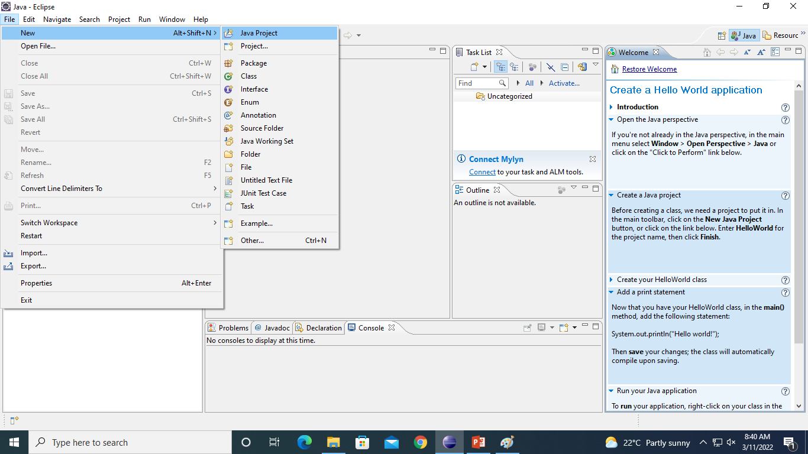
Eclipse steps to run program

Slide 7
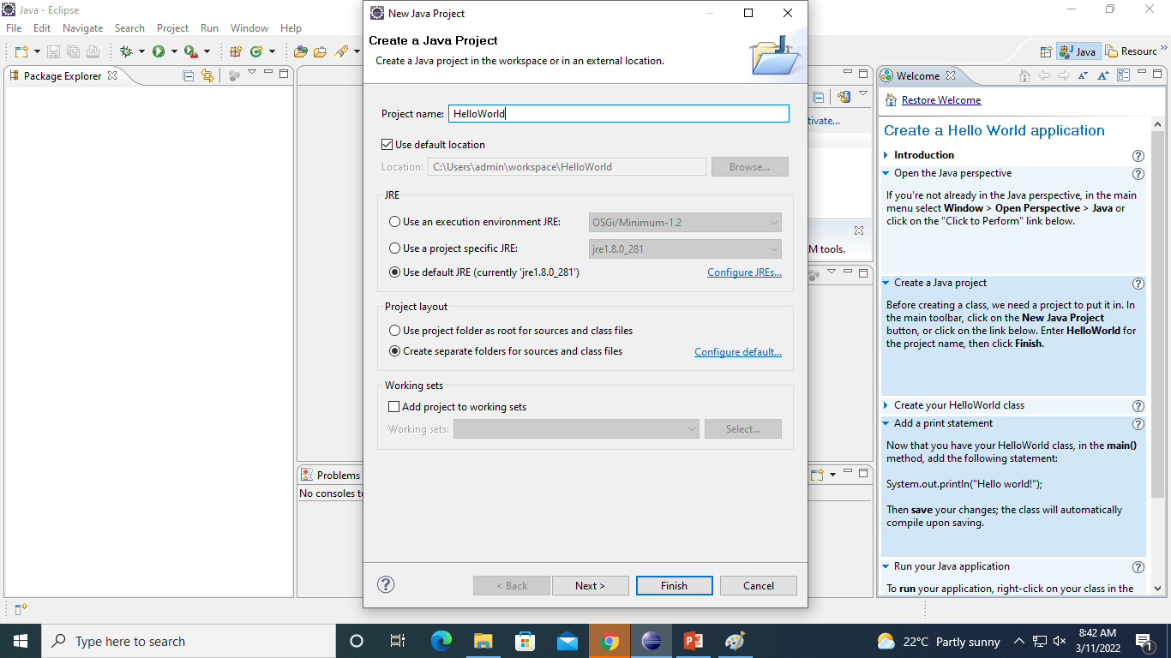

Slide 8
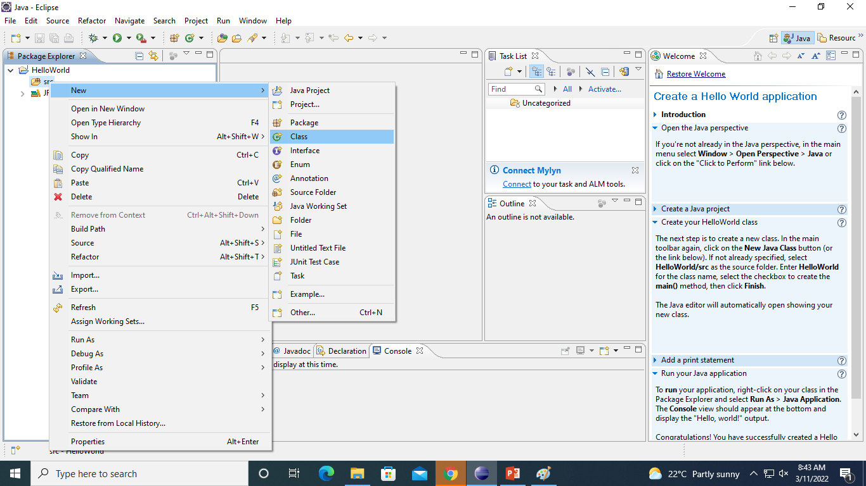

Slide 9
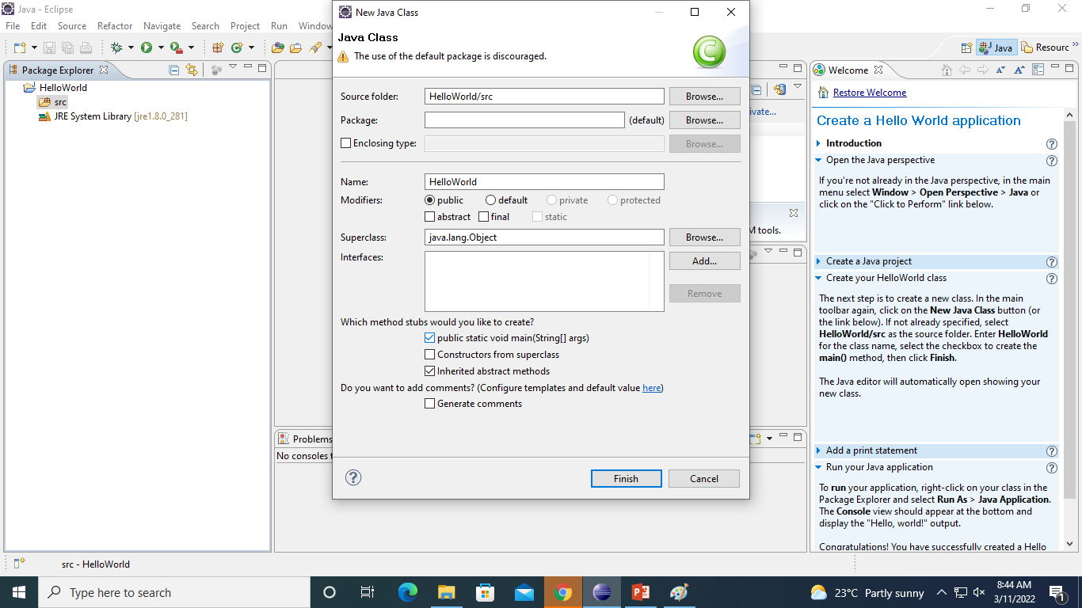

Slide 10
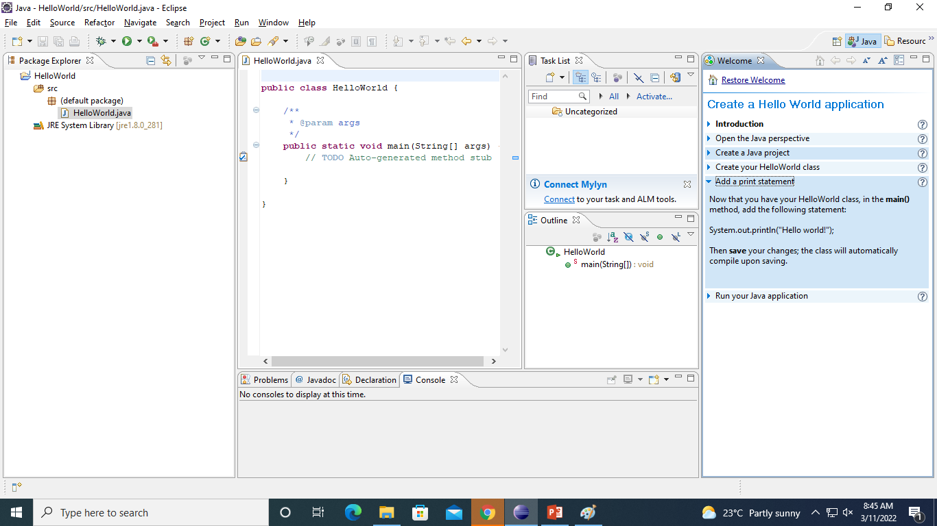

Slide 11
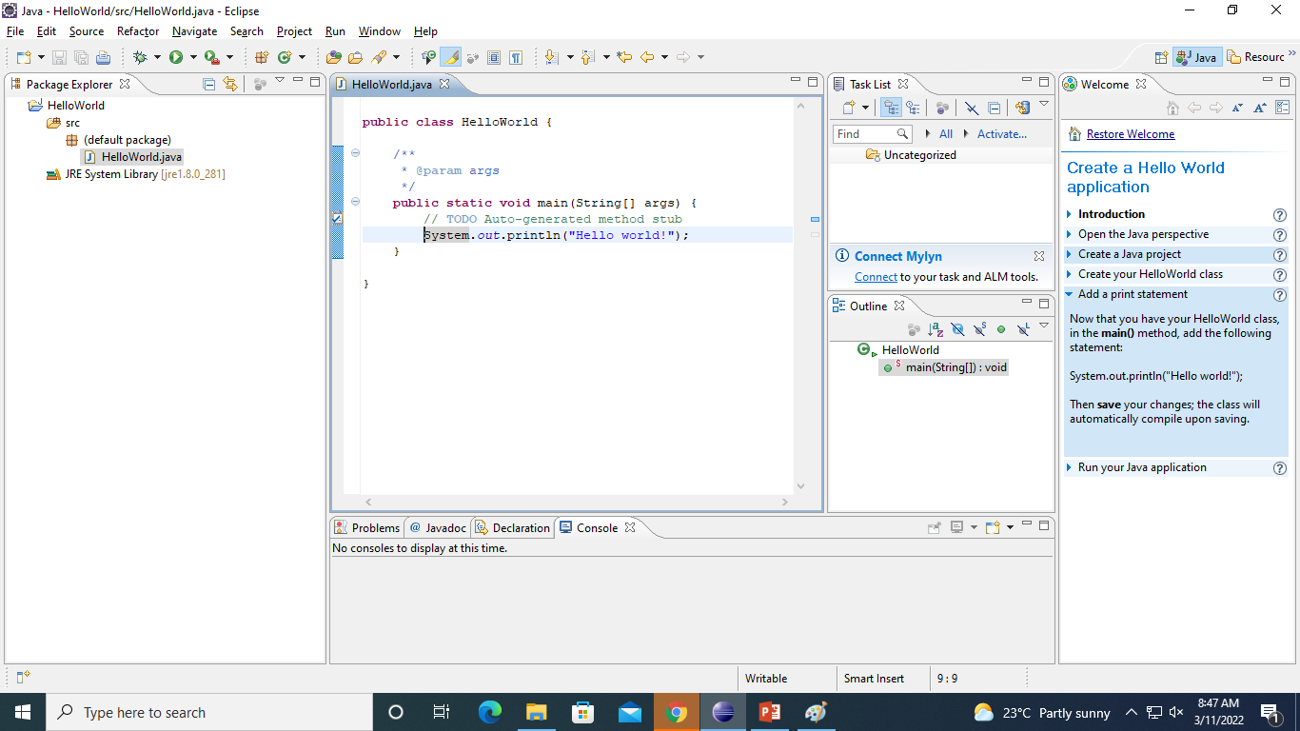

Slide 12
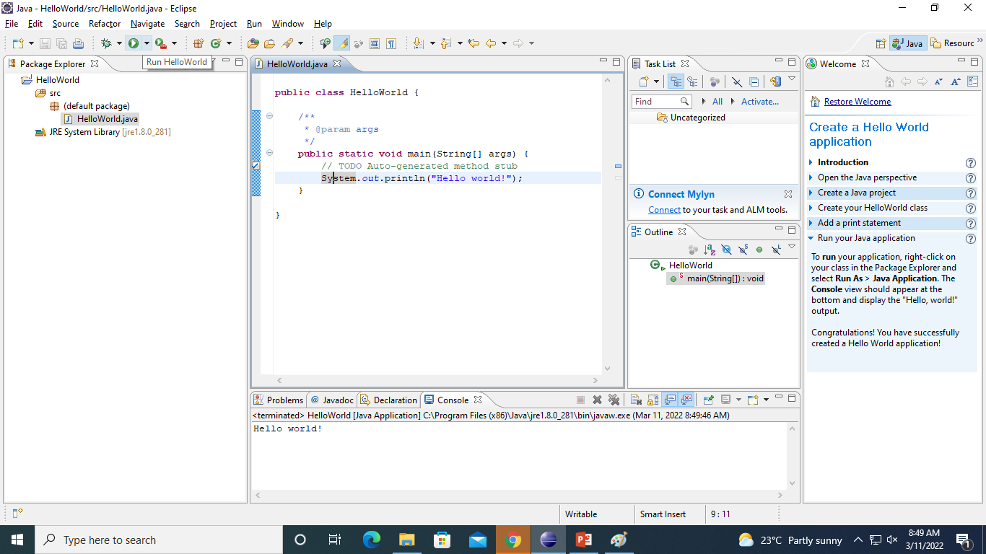

Slide 13
Java Programming-The General Form of Class
A class a new (user defined) data type. Once defined, this new type can be used to create objects of that type.
A class contains three types of items : variable, methods, and constructors.
Variable represent its state.
Method provide the logic that constitutes the behavior defined by a class.
Collectively, the methods and variables defined within a class are called members of the class.
Constructors initialize the state of a new instance of a class.

Slide 14
General Form of Class contd….
The Simplified form of a class is :
class clsName {
//instance variable declarations
type1 varName1;
type2 varName2;
…..
//constructor
clsName(cparams1) {
// body of constructor
}

Slide 15
clsName(cparamsN) {
//body of constructor
}
…
//methods
rtype1 mthName(mparams1) {
//body of method }
…..
} }
The keyword class indicates that a class named clsName is being declared. This name must follow the Java naming convention for identifiers. The instance Variables named varName1 through varNameN included using the normal variable declaration syntax. Each variable must be assigned a type shown as

Slide 16
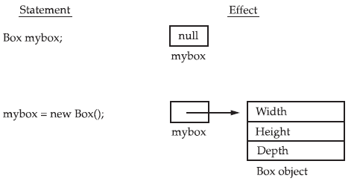
Example of a Simple Class & object
class Box {
double width;
double height;
double depth;
}
class object creation :-
2-steps for creating objects
Box mybox; // declare reference to object
mybox = new Box(); // // allocate a Box object
OR
Box mybox = new Box(); // or create a Box object called mybox in 1-step
Here mybox is a object of class Box.
Each time you create an instance of a class, you are creating an object that contains its own copy of each instance variable defined by the class.
Thus, every Box object will contain its own copies of the instance variables width, height, and depth.
To access these variables, you will use the dot (.) operator. The dot operator links the name of the object with the name of an instance variable.
Ex:- mybox.width = 100;

Slide 17
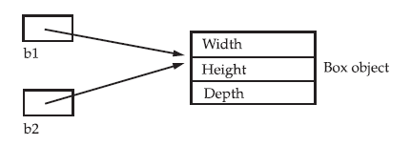
Assigning Object Reference Variables
Box b1 = new Box();
Box b2 = b1;

Slide 18
Program example for classes & object
class Box {
double width;
double height;
double depth;
}
class BoxDemo2 {
public static void main(String args[]) {
Box mybox1 = new Box();
Box mybox2 = new Box();
double vol;
// assign values to mybox1's instance variables
mybox1.width = 10;
mybox1.height = 20;
mybox1.depth = 15;

Slide 19
/* assign different values to mybox2's
instance variables */
mybox2.width = 3;
mybox2.height = 6;
mybox2.depth = 9;
// compute volume of first box
vol = mybox1.width * mybox1.height * mybox1.depth;
System.out.println("Volume is " + vol);
// compute volume of second box
vol = mybox2.width * mybox2.height * mybox2.depth;
System.out.println("Volume is " + vol);
}
}

Slide 20
Constructors
Java allows objects to initialize themselves when they are created. This automatic initialization is performed through the use of a constructor.
A constructor initializes an object immediately upon creation. It has the same name as the class in which it resides and is syntactically similar to a method.
Once defined, the constructor is automatically called immediately after the object is created, before the new operator completes.
Note :- They have no return type, not even void.

Slide 21
Constructor example
class Box {
double width;
double height;
double depth;
// This is the constructor for Box.
Box() {
System.out.println("Constructing Box");
width = 10;
height = 10;
depth = 10;
}
// compute and return volume
double volume() {
return width * height * depth;
}
}
class BoxDemo6 {
public static void main(String args[]) {
// declare, allocate, and initialize Box objects
Box mybox1 = new Box();
Box mybox2 = new Box();
double vol;
// get volume of first box
vol = mybox1.volume();
System.out.println("Volume is " + vol);
// get volume of second box
vol = mybox2.volume();
System.out.println("Volume is " + vol);
}
}

Slide 22
Introducing Methods
This is the general form of a method:
type name(parameter-list) {
// body of method
}

Slide 23
Introduction to Access Control
Encapsulation provides important attribute: access control
Through encapsulation, you can control what parts of a program can access the members of a class.
By controlling access, you can prevent misuse. For example, allowing access to data only through a well defined set of methods, you can prevent the misuse of that data.
How a member can be accessed is determined by the access specifier that modifies its declaration.
Java supplies a rich set of access specifiers.

Slide 24
Java’s access specifiers are public, private, and protected.
Java also defines a default access level. When no access specifier is used, then by default the member of a class is public within its own package, but cannot be accessed outside of its package.
Protected applies only when inheritance is involved.
The other access specifiers are described next.

Slide 25
Program to demonstrate the difference between public and private
/* This program demonstrates the difference between public and private.
*/
class Test {
int a; // default access
public int b; // public access
private int c; // private access
// methods to access c
void setc(int i) { // set c's value
c = i;
}
int getc() { // get c's value
return c;
}
}
class AccessTest {
public static void main(String args[]) {
Test ob = new Test();
// These are OK, a and b may be accessed directly
ob.a = 10;
ob.b = 20;
// This is not OK and will cause an error
// ob.c = 100; // Error!
// You must access c through its methods
ob.setc(100); // OK
System.out.println("a, b, and c: " + ob.a + " " + ob.b + " " + ob.getc());
}
}

Slide 26
Adding a Method to the Box Class
class Box {
double width;
double height;
double depth;
// display volume of a box
void volume() {
System.out.print("Volume is ");
System.out.println(width * height * depth);
}
}

Slide 27
Adding a Method to the Box Class contd..
class BoxDemo3 {
public static void main(String args[]) {
Box mybox1 = new Box();
Box mybox2 = new Box();
// assign values to mybox1's instance variables
mybox1.width = 10;
mybox1.height = 20;
mybox1.depth = 15;
/* assign different values to mybox2's instance variables */
mybox2.width = 3;
mybox2.height = 6;
mybox2.depth = 9;
// display volume of first box
mybox1.volume();
// display volume of second box
mybox2.volume(); } }

Slide 28
Returning a Value
class Box {
double width;
double height;
double depth;
// compute and return volume
double volume() {
return width * height * depth;
}
}

Slide 29
Program example returning a Value
class BoxDemo4 {
public static void main(String args[]) {
Box mybox1 = new Box();
Box mybox2 = new Box();
double vol;
// assign values to mybox1's instance variables
mybox1.width = 10;
mybox1.height = 20;
mybox1.depth = 15;
/* assign different values to mybox2's
instance variables */
mybox2.width = 3;
mybox2.height = 6;
mybox2.depth = 9;

Slide 30
Program example returning a Value contd…
// get volume of first box
vol = mybox1.volume();
System.out.println("Volume is " + vol);
// get volume of second box
vol = mybox2.volume();
System.out.println("Volume is " + vol);
}
}

Slide 31
Adding a Method That Takes Parameters
class Box {
double width;
double height;
double depth;
// compute and return volume
double volume() {
return width * height * depth;
}
// sets dimensions of box
void setDim(double w, double h, double d) {
width = w;
height = h;
depth = d;
}
}

Slide 32
Adding a Method That Takes Parameters contd..
class BoxDemo5 {
public static void main(String args[]) {
Box mybox1 = new Box();
Box mybox2 = new Box();
double vol;
// initialize each box
mybox1.setDim(10, 20, 15);
mybox2.setDim(3, 6, 9);
// get volume of first box
vol = mybox1.volume();
System.out.println("Volume is " + vol);
// get volume of second box
vol = mybox2.volume();
System.out.println("Volume is " + vol);
}
}

Slide 33
import java.util.Scanner; // Import the Scanner class
class Main {
public static void main(String[] args) {
Scanner myObj = new Scanner(System.in); // Create a Scanner object
System.out.println("Enter username");
String userName = myObj.nextLine(); // Read user input
System.out.println("Username is: " + userName); // Output user input
}
}

Slide 34
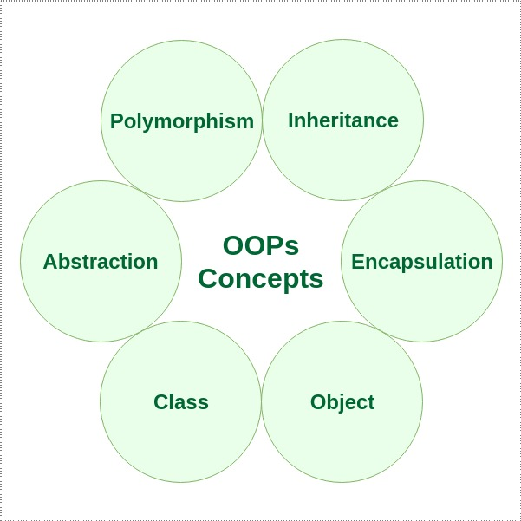
OOPs concepts in Java

Slide 35
Classes and Objects
A class is a user-defined blueprint or prototype from which objects are created.
It represents the set of properties or methods that are common to all objects of one type.
Using classes, you can create multiple objects with the same behavior instead of writing their code multiple times.
An object is a basic unit of Object-Oriented Programming that represents real-life entities. A typical Java program creates many objects, which as you know, interact by invoking methods. An object mainly consists of:
State: It is represented by the attributes of an object. It also reflects the properties of an object.
Behavior: It is represented by the methods of an object. It also reflects the response of an object to other objects.
Identity: It is a unique name given to an object that enables it to interact with other objects.

Slide 36
Data Abstraction
Data Abstraction is the property by virtue of which only the essential details are displayed to the user. The trivial or non-essential units are not displayed to the user. Ex: A car is viewed as a car rather than its individual components.
Data Abstraction may also be defined as the process of identifying only the required characteristics of an object, ignoring the irrelevant details. The properties and behaviors of an object differentiate it from other objects of similar type and also help in classifying/grouping the object.
In Java, abstraction is achieved by
Interfaces
Abstract Classes

Slide 37
Encapsulation
It is the mechanism that binds together the code and the data it manipulates.
Another way to think about encapsulation is that it is a protective shield that prevents the data from being accessed by the code outside this shield.
In encapsulation, the data in a class is hidden from other classes, which is similar to what data-hiding does. So, the terms “encapsulation” and “data-hiding” are used interchangeably.
Encapsulation can be achieved by declaring all the variables in a class as private and writing public methods in the class to set and get the values of the variables.

Slide 38
Inheritance
Inheritance is the mechanism in Java by which one class is allowed to inherit the features (fields and methods) of another class. We are achieving inheritance by using extends keyword. Inheritance is also known as “is-a” relationship.
Some frequently used important terminologies:
Superclass: The class whose features are inherited is known as superclass (also known as base or parent class).
Subclass: The class that inherits the other class is known as subclass (also known as derived or extended or child class). The subclass can add its own fields and methods in addition to the superclass fields and methods.
Reusability: Inheritance supports the concept of “reusability”, i.e. when we want to create a new class and there is already a class that includes some of the code that we want, we can derive our new class from the existing class. By doing this, we are reusing the fields and methods of the existing class.

Slide 39
References
Java™: The Complete Reference
-by Herbert Schildt

